Slide 1
Vitamin D is a Potent Anti-Cancer Agent
Megan Riley
March 31, 2011

Slide 2
How did we get here?
1912: “vitamine”
1919: rickets in dogs, found cod liver oil to be an anti-rickets agent
1922: Elmer McCollum- “Vitamin D”
1930s: fortify with vitamin D
1951: vitamin D treatment for Hodgkin’s disease

Slide 3
http://www.youtube.com/watch?v=kMeUc0XVLPo

Slide 4
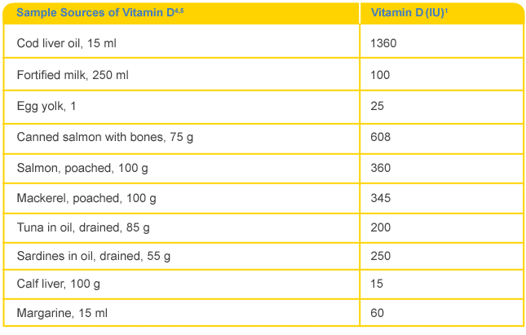
Sunlight, supplements, or...

Slide 5
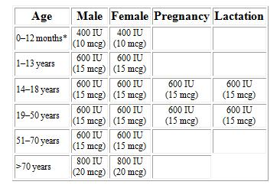
How much vitamin D?

Slide 6
Vitamin D test
Vitamin D 25 Hydroxy level 25(OH)D level 25OHD level 25 hydroxyvitamin D Level
serum 25-OHD concentration
*Serum is the yellowish component of blood that is left when the blood clots

Slide 7
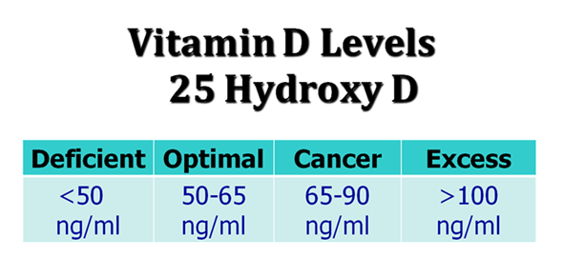
*If your test results are measured in nmol/l, simply multiply the above values by 2.5 to get the correct ranges.

Slide 8
Vitamin D Level Recommendations
 | Minimum Optimal (ng/ml) | High End of Optimum (ng/ml) | Toxic Level (ng/ml)
Bruce Hollis(ng/ml) | 32 |  | >250
Vitamin D Council (ng/ml) | 50 | 80
Vitamin D, A Neglected ‘Analgesic’ for Chronic Musculoskeletal Pain(ng/ml) | 30 | 50 | >150
Dr. Mercola (ng/ml) | 50 | 65 | >100 (excess)
The Use of Vitamin D in Clinical Practice (ng/ml) | 40 | 70 | > 150

Slide 9
1989
Garland et. al
Eight-year prospective study
Risk of colon cancer was reduced by 75% in the third quintile (27-32 ng/ml)
and by 80% in the fourth quintile (33-41 ng/ml) of serum 25-OHD.

Slide 10
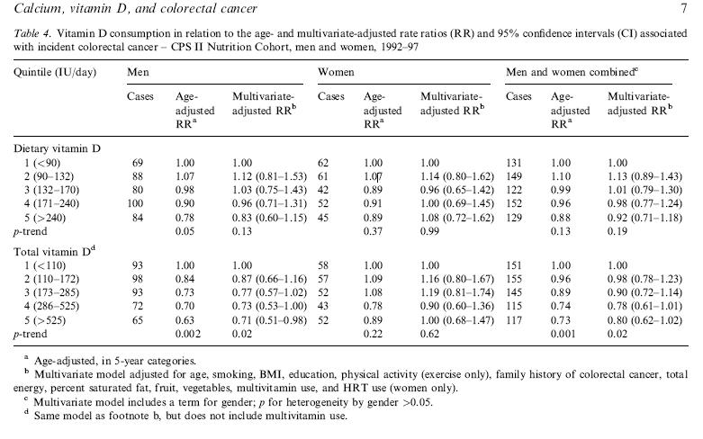
Today

Slide 11
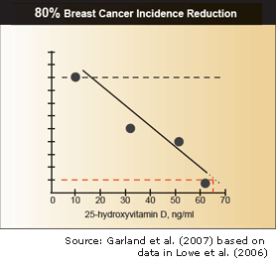

Slide 13
How does Vitamin D affect cancer?
Regulate cell cycles
Force cell death
Resist signals from substances which cause cancer cells to grow
Inhibit invasion into normal tissue
Prevent metastasis
Preventing the formation of excessive blood vessel growth around the tumor

Slide 14
Vitamin D toxicity
Too much calcium in urine
0 reported deaths from vitamin D toxicity
http://www.youtube.com/watch?v=k-sGrBE_n5c&feature=related

Slide 15
Cultural
“According to scientific studies, right now 70 percent of whites are deficient in vitamin D, and 97 percent of African Americans are deficient, resulting in outrageously higher rates of cancer among [African Americans]”
-Adams, 2010

Slide 16
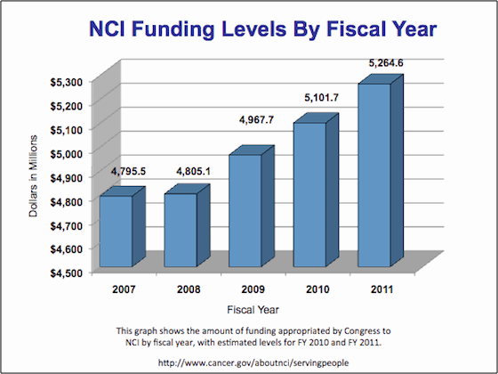
Governmental

Slide 17
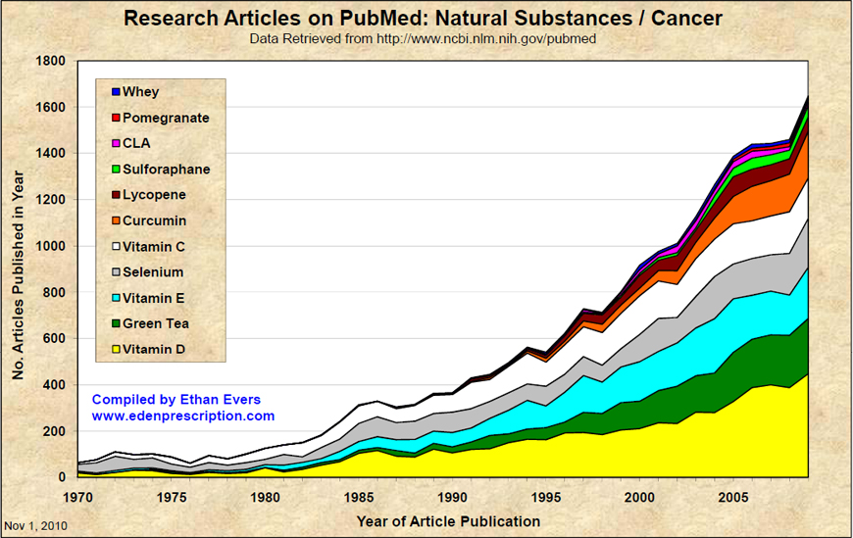
The future is sunny…with a chance of vitamin D

Slide 18
Future
A single study can’t decisively resolve the question
"Among the questions to be addressed in future studies is the relationship between vitamin D levels and future cancer risk both for individual cancer sites and for total cancer risk.“
–Freedman

Slide 19
References
Garland, C. F., Garland, F. C., Shaw, E. K., Comstock, G. W., Helsing, K. J., & Gorham, E. D. (1989). Serum 25-hydorxyvitamin d and colon cancer: eight-year prospective study. The Lancet vol. 334 , 1176-1178.
McCullough ML, R. A. (2003). Calcium, vitamin D, dairy products, and risk of colorectal cancer in the Cancer Prevention Study II Nutrition Cohort (United States). Cancer Causes Control vol, 14.1 , 1-12.
Owens, L. (2010, January 12). Vitamin D Stimulates Anti Breast Cancer Protein. Retrieved February 22, 2011, from suite101.com: http://www.suite101.com/content/vitamin-d-stimulates-anti-breast-cancer-protein-a188367
Rhodes, P. (2008, May 20). Vitamin D is hot! Here's how to get it. Retrieved February 28, 2011, from CNN Health: http://articles.cnn.com/2008-05-20/health/cl.vitamin.d_1_vitamin-adequate-intake-international-units/3?_s=PM:HEALTH
Vitamin D. (2010, November 24). Retrieved February 28, 2011, from MedlinePlus: http://www.nlm.nih.gov/medlineplus/druginfo/natural/929.html
Vitamin D and Cancer Prevention: Strengths and Limits of the Evidence. (2010, June 16). Retrieved February 28, 2011, from National Cancer Institute: http://www.cancer.gov/cancertopics/factsheet/prevention/vitamin-D
www.cdc.gov
www.ncbi.nim.nih.gov
www.lewrockwell.com/orig5/mercola7.1.1.html

